Slide 1
START Hack Case
The Farmers’ Dilemma:
Help them to Feed the World whilst
Protecting their Land
GDSC Polimi 2

Slide 2





Situation Today
?
?
?
I understand!!!

Slide 3

CROPPY
PLANT PIXELS, HARVEST REALITY

Slide 4
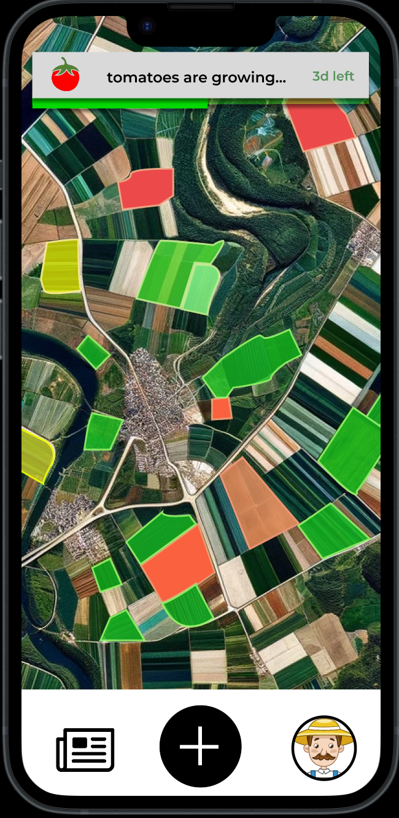
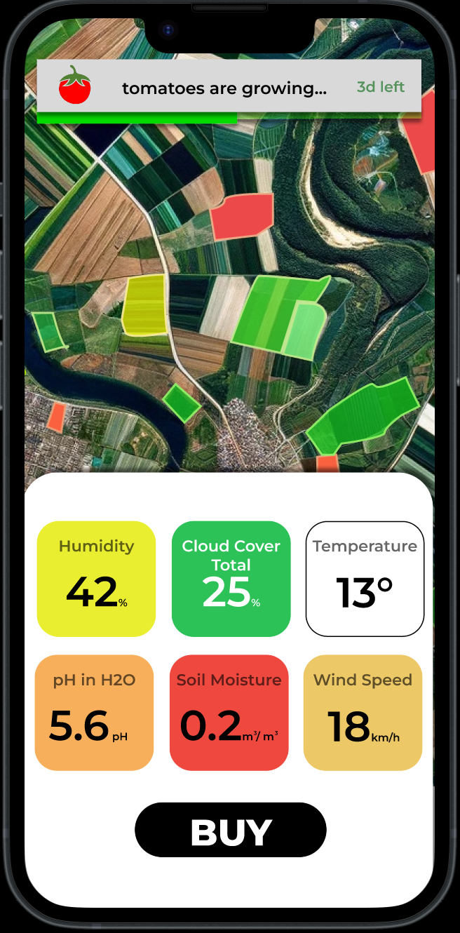
Based on real data
Geographic data
Weather data
Soil condition

Slide 5
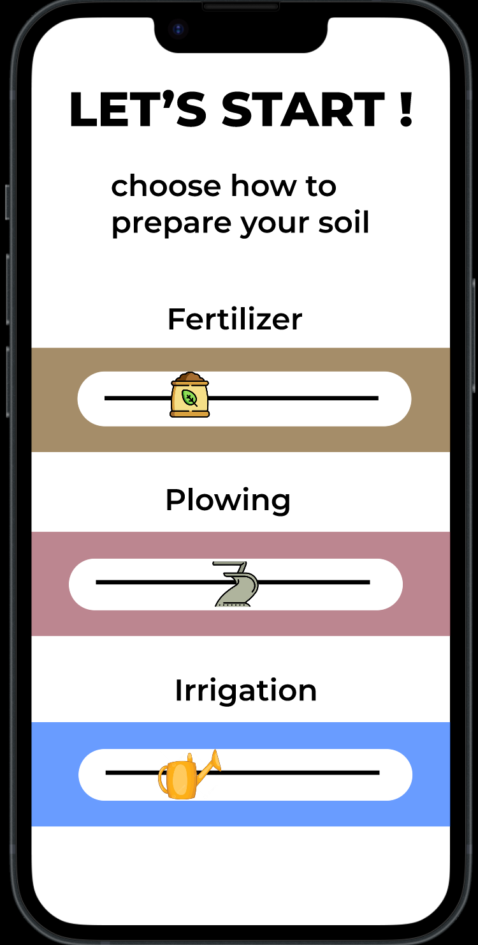
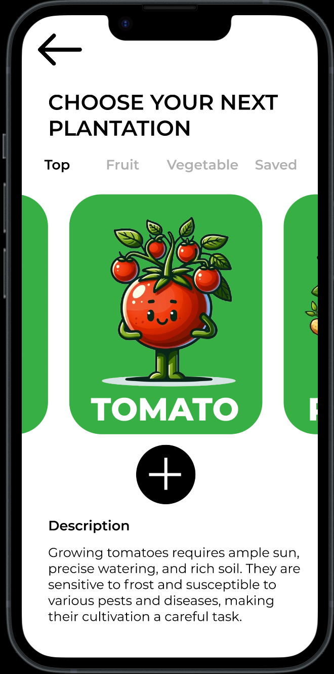
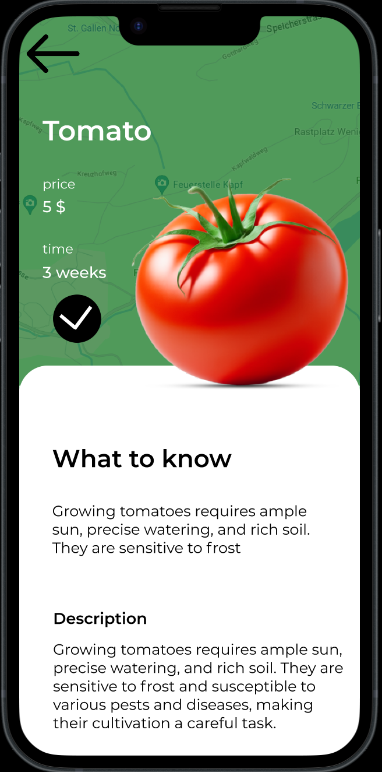
Provide support to user decisions
Options to prepare soil
Scientific information about crops
Suggestions of actions

Slide 6
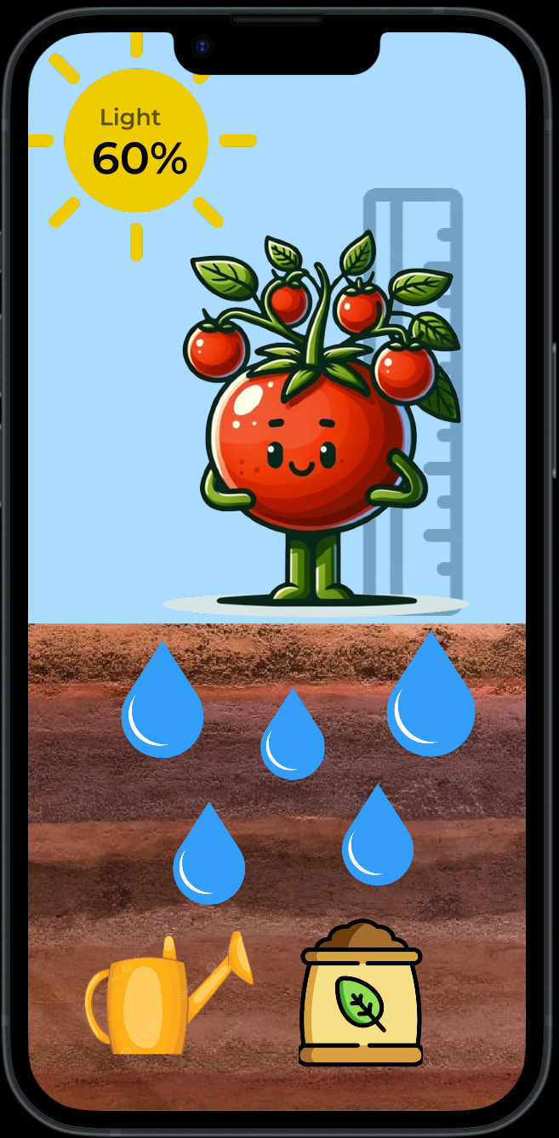
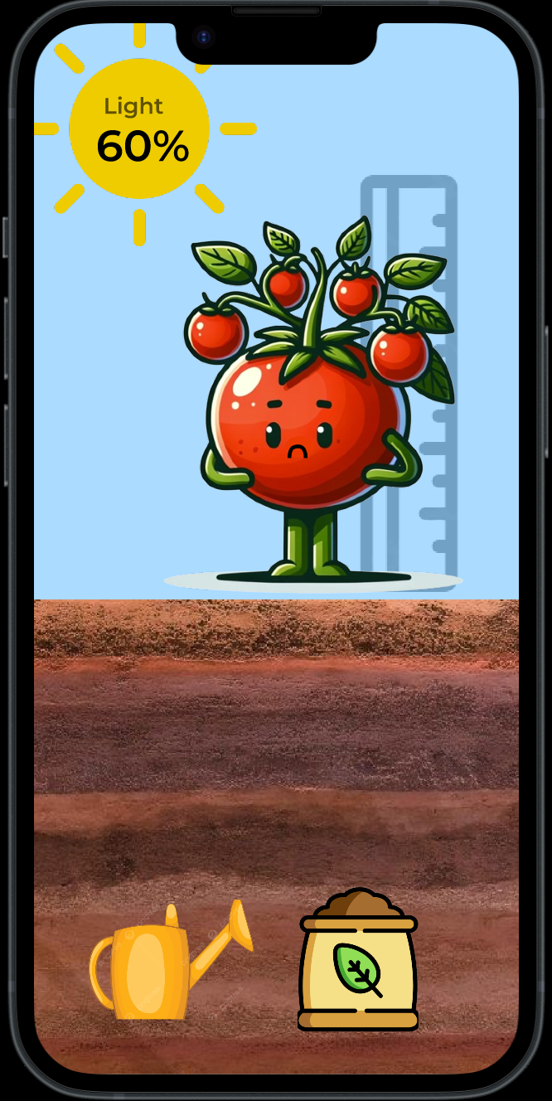
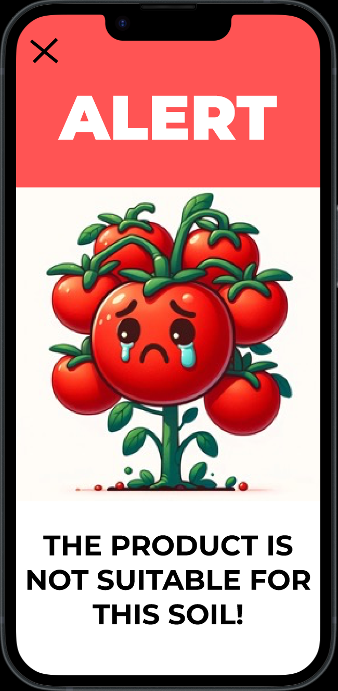
Learning by doing

Slide 7
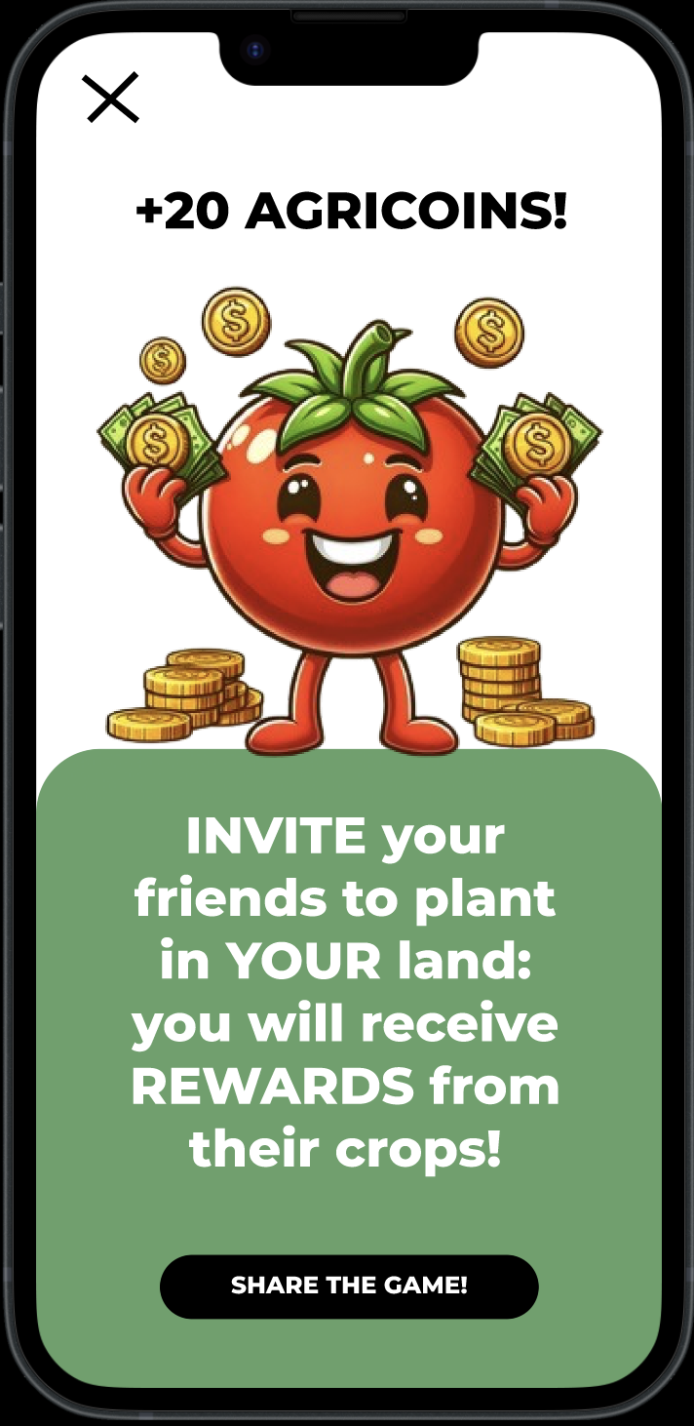
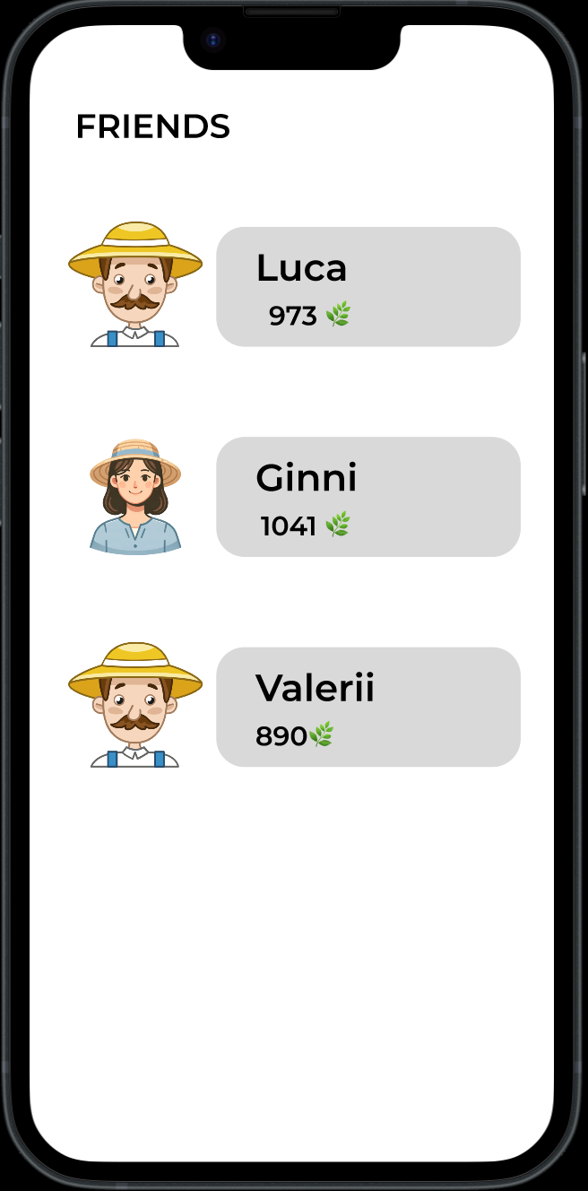
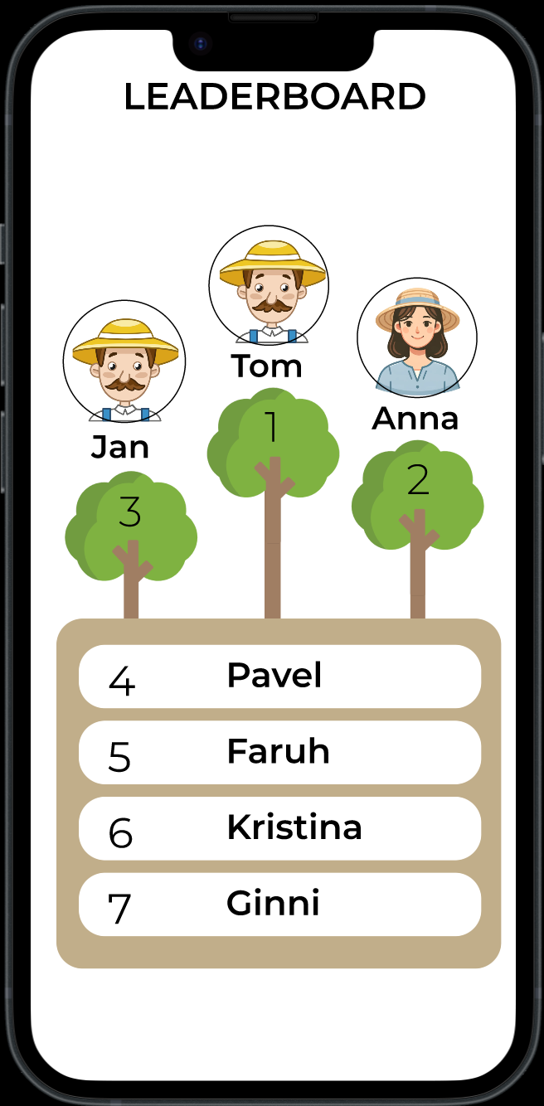
Community
Learn with your friends
Share results with your friends
Compete with the community

Slide 8



Do you want physical rewards?
Let’s make it real! Join Croppy Pro!
User
Farmer
Food

Slide 9
How do we educate people?
01
02
03
04
05
Try a real farmer experience
Gamified approach
Learn by mistakes
Get real products
Advices from experts

Slide 10

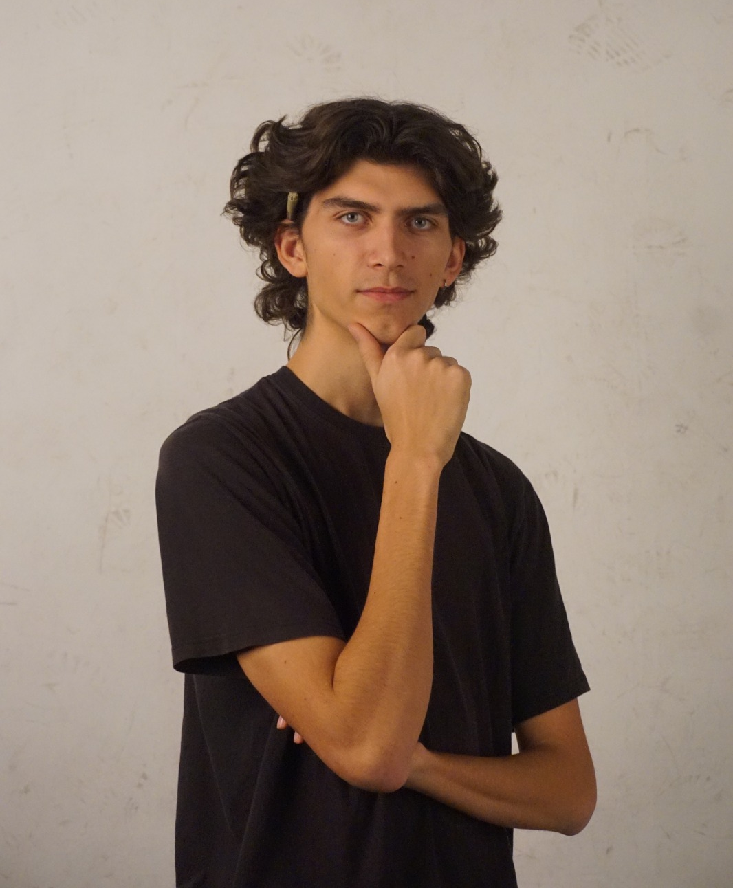
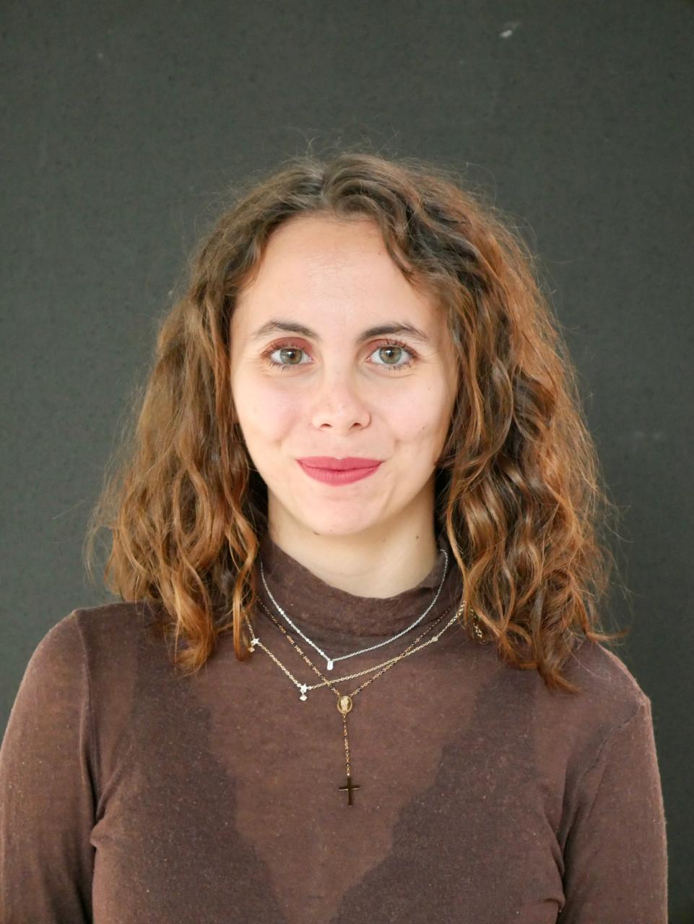
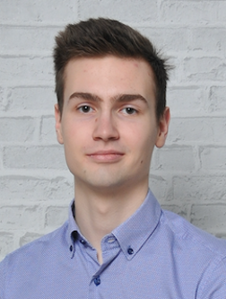
Thanks for your attention!
Ginevra Carradori
Valerii Stakanov
Luca Ortolomo
Alessandro Daz

